Slide 1
Microservices Using Istio Service Mesh

Slide 2
PROBLEM STATEMENT
Create a microservice architecture based application.
Develop UI for stock ticker
Two microservices required- one connecting to Google finance, other to Yahoo finance to pull stocks
One intermediate service that communicates with the two.
Use Istio framework as mesh service

Slide 3
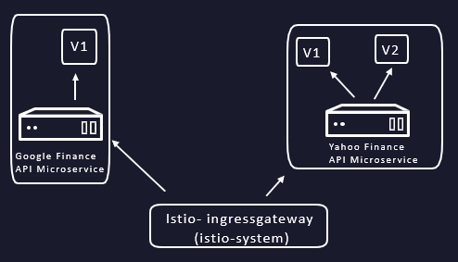
MICROSERVICE ARCHITECTURE
Created two microservices.
One service connects to Google finance to pull stock quotes while the other connects to Yahoo finance or any service alike.
Created a third intermediate service that communicates with these two services.
The UI will communicate only with this third service to display the stock information.

Slide 4
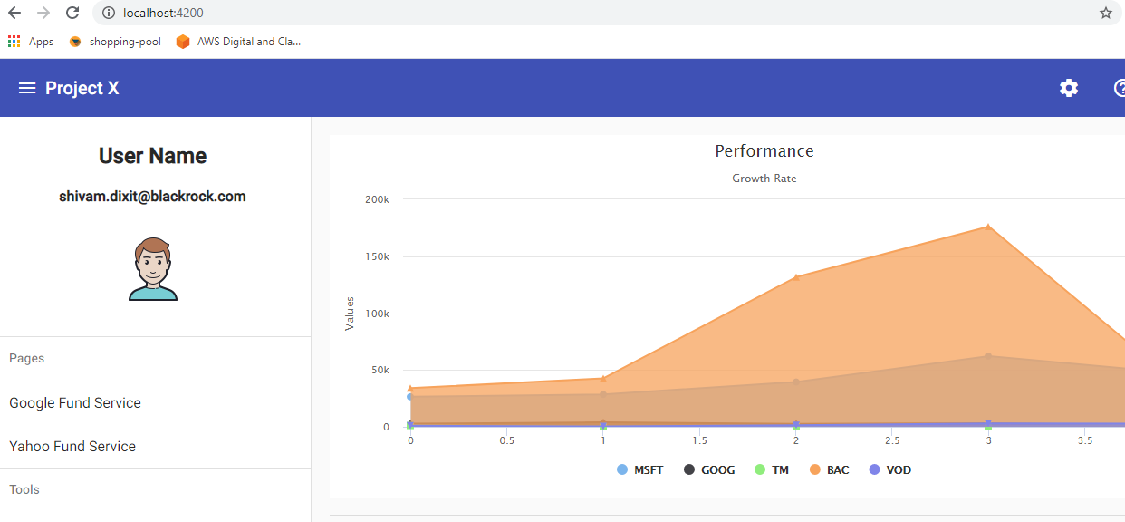
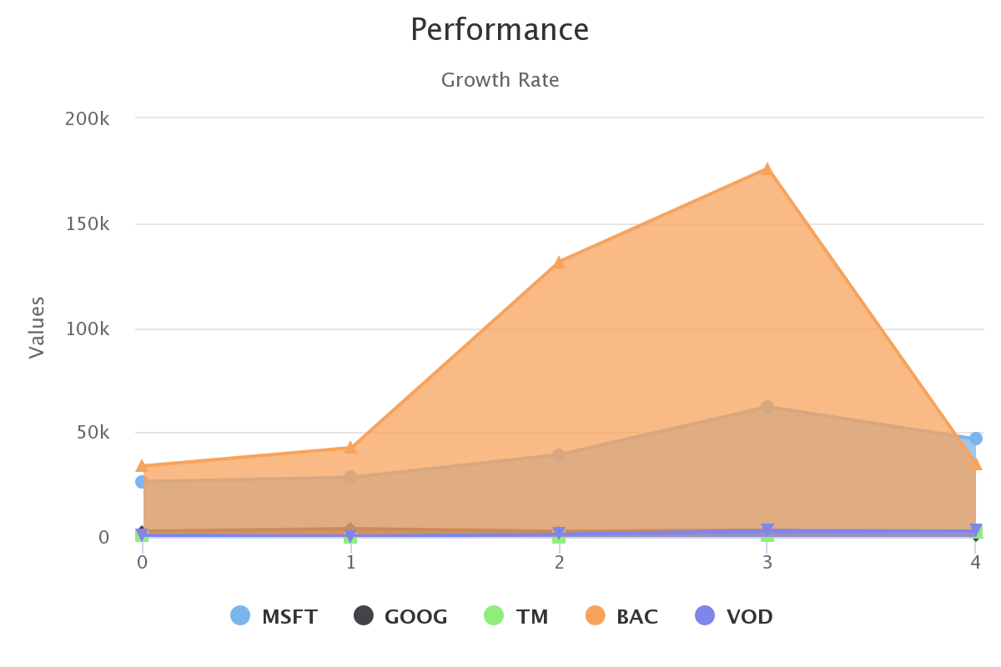
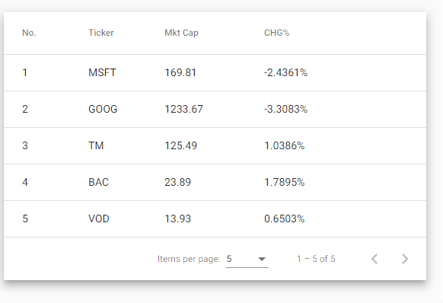
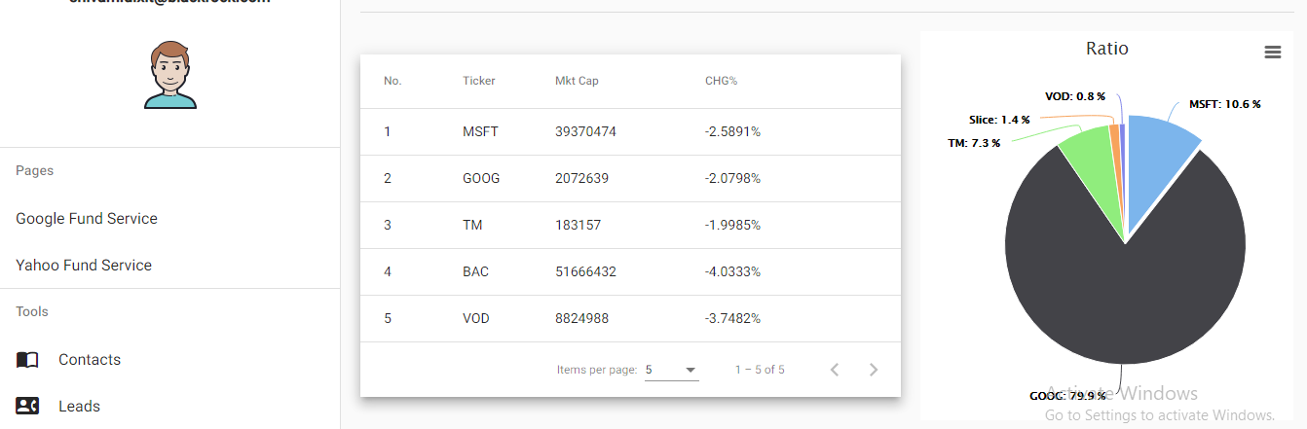
USER INTERFACE- ANGULAR 8
Data taken in the form of JSON object
Processed and populated in Highcharts

Slide 5
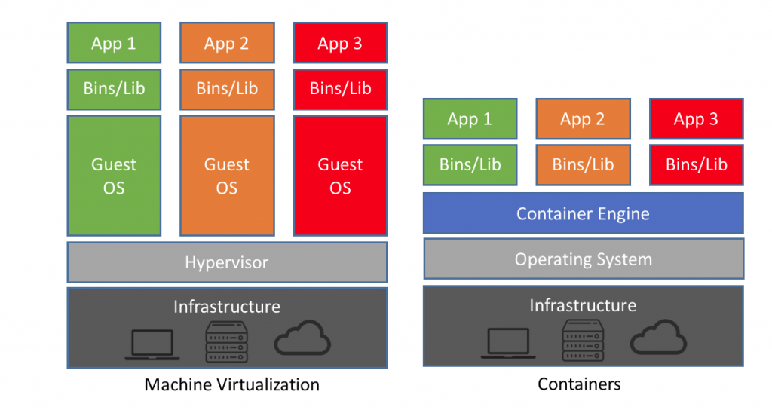
DOCKER
Docker
Kubernetes
Istio
Used to containerise applications into Docker image files
Operated on any computer with docker
Not VMs
Automate Deployments in light weight containers so that applications can work efficiently in different environments.
Process of deployment

Slide 6
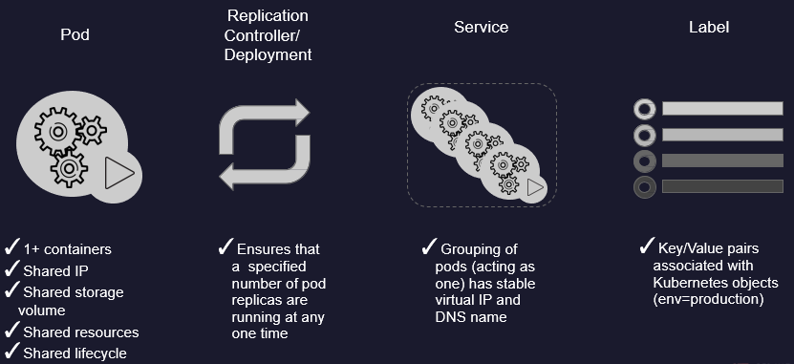
Container orchestration- Kubernetes

Slide 7
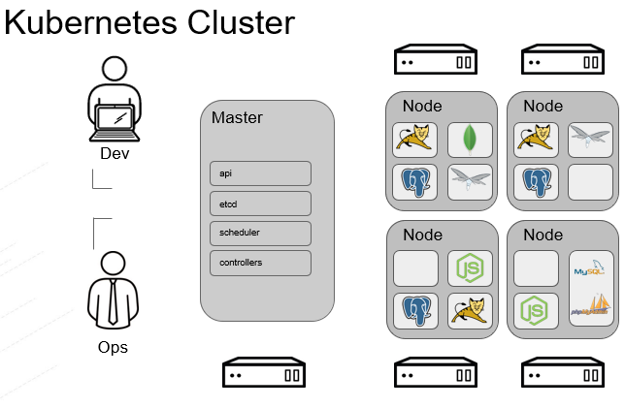

Slide 8
What is Istio?
Automatic load balancing for HTTP, gRPC, WebSocket, and TCP traffic.
Fine-grained control of traffic behavior with rich routing rules, retries, failovers, and fault injection.
Automatic metrics, logs, and traces for all traffic within a cluster, including cluster ingress and egress.
A pluggable policy layer and configuration API supporting access controls, rate limits and quotas.
Secure service-to-service communication in a cluster with strong identity-based authentication and authorization.

Slide 9
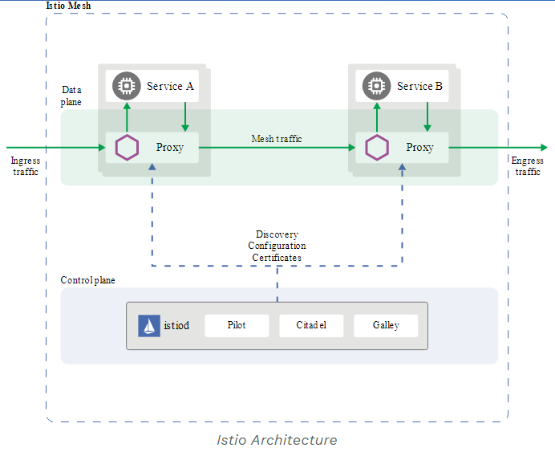
ISTIO Concepts
Data Plane: Composed of a set of intelligent
proxies (Envoy) deployed as sidecars.
These proxies mediate and control all
network communication between
microservices along with Mixer,
a general-purpose policy and telemetry hub.
Control Plane: Manages and configures the proxies to route traffic. Additionally, the control plane configures Mixers to enforce policies and collect telemetry.
Proxy: Based on Envoy, mediates inbound and outbound traffic for all Istio-managed services.
Pilot: Configures Istio deployments and propagate configuration to the other components of the system.
Citadel: Secures the service-to-service communication and provides a key management system to manage keys and certificates.

Slide 10
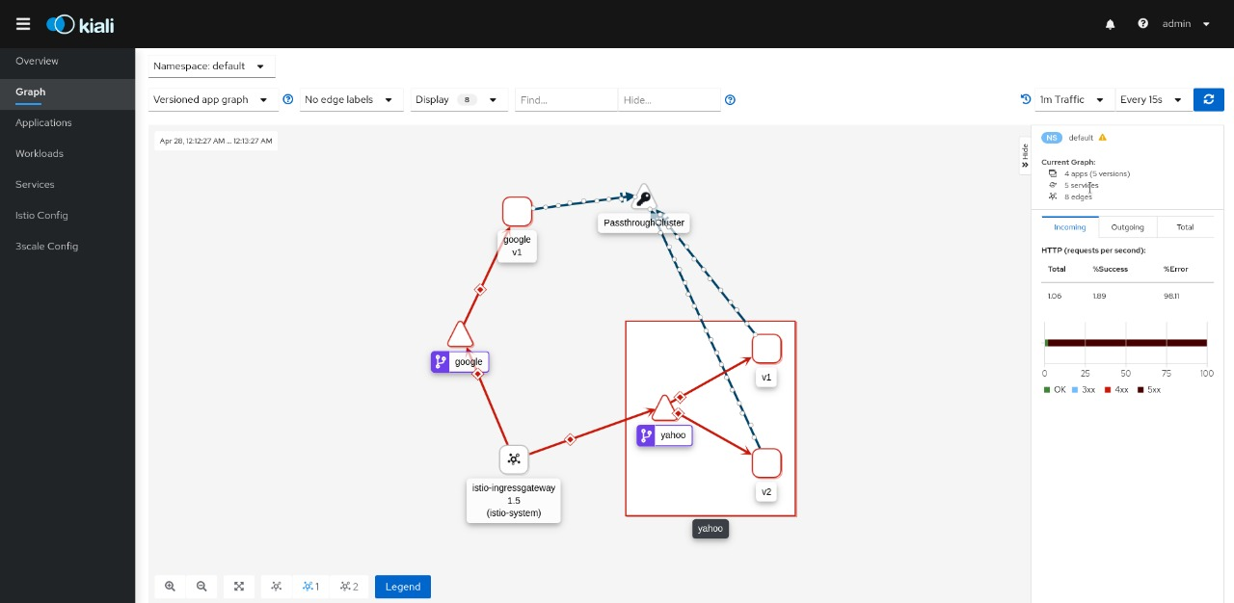
Kiali Dashboard representation of Service Mesh

Slide 11
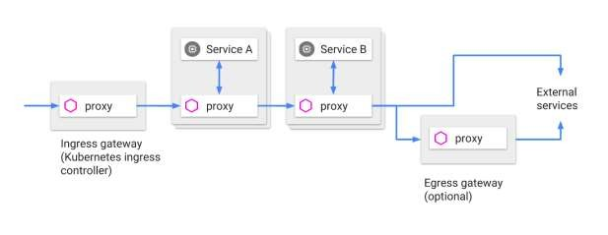
ROUTING CONTROL
Ingress
Gateway: configures a load balancer (one or multiple FQDN) for HTTP/TCP traffic at the edge of the mesh
Inside mesh
VirtualService: defines the rules that control how requests for a service (one or multiple FQDN) are routed.
DestinationRule: configures the set of policies (a set of instances) to be applied to a request after VirtualService routing has occurred
Egress
ServiceEntry: commonly used to enable requests to services outside of an
Istio service mesh

Slide 12
HOW ROUTING CONTROL ACHIEVED
routegateway.yml
apiVersion: networking.istio.io/v1beta1
kind: Gateway
metadata:
name: stock-gateway
spec:
selector:
istio: ingressgateway
controller
servers:
- port:
number: 80
name: http
protocol: HTTP
hosts:
- ""
---
apiVersion: networking.istio.io/v1alpha3
kind: VirtualService
metadata:
name: stockserver
spec:
hosts:
- ""
gateways:
- stock-gateway
http:
- match:
- header:
HeaderApi: google-api
- uri:
prefix: /getAllStocks
route:
- destination:
host: google
port:
number: 8081
- match:
- header:
HeaderApi: yahoo-api
- uri:
prefix: /getAllStocks
route:
- destination:
host: yahoo
subset: v1
port:
number: 8080
weight: 50
- destination:
host: yahoo
subset: v2
port:
number: 8080
weight: 50

Slide 13
Traffic Shifting
Traffic Shifting is basically about how do we shift from one version of a microservice to another version.
For example let's assume there are three versions v1,v2,v3 of a microservice m1, where v1 is the older version and v2, v3 are new modified versions of the microservice.
We can migrate from v1 to v2 or v3 using traffic shifting logic.

Slide 14
Route Shifting Example
Google Finance Microservice
v1
Ingress Gateway
v1
Yahoo Finance Microservice

Slide 15
Proportional Traffic Shifting
This is the method via which we can route the traffic proportionally to different versions of a microservice as per the weights defined in the yaml file.
$ kubectl apply -f samples/<application>/networking/traffic-proportional.yml

Slide 16
Proportional Traffic Shifting
traffic-proprtion.yml
apiVersion: networking.istio.io/v1alpha3
kind: VirtualService
metadata:
name: stock-traffic-service
...
spec:
hosts:
- yahoo
http:
- route:
- destination:
host: yahoo
subset: v1
weight: 50
- destination:
host: yahoo
subset: v2
weight: 50
v1
Yahoo Finance Microservice
v2
Gateway
v1
Google Finance Microservice

Slide 17
API Objects in Service Mesh
There are different API Objects used in Service Mesh -
Virtual Service
Destination Rule
Service Entry

Slide 18
Virtual Service
VirtualService defines a set of traffic routing rules to apply when a host is addressed. Each routing rule defines matching criteria for traffic of a specific protocol. If the traffic is matched, then it is sent to a named destination service defined in the registry.
Service is a unit of application behavior bound to a service registry. Services consist of multiple endpoints implemented by load instances running on pods, containers.
Service versions - In a continuous deployment scenario, for a given service, there can be distinct versions running different variants of the application.

Slide 19
Source - A client calling a service.
Host - The address used by a client when attempting to connect to a service.
Access model - Applications address only the HOST without knowledge of individual service versions. The actual choice of the version is determined by the proxy/sidecar, enabling the application code to decouple itself from the evolution of dependent services.

Slide 20
Destination Rule
DestinationRule defines rules that apply to traffic intended for a service after the step of routing. These rules specify configuration for load balancing, connection pool size from the sidecar, and outlier detection settings to detect and remove unfit/unhealthy hosts from the load balancing pool.

Slide 21
Service Entry
ServiceEntry enables adding additional entries into Istio’s internal service registry, so that auto-discovered services in the mesh can access/route to these manually specified services. A service entry describes the properties of a service like Ports, Protocols, DNS.

Slide 22
Other kind of Requests
HTTPFaultInjection - To inject faults while forwarding the HTTP requests.
HttpFaultInjection
HttpFaultInjection.delay
HttpFaultInjection.abort

Slide 23
HttpMatchRequest specifies a set of criterion to be met in order for the rule to be applied to the HTTP request.
HTTPRedirect can be used to send a 301 redirect response to the caller, where the Authority/Host and the URI in the response can be swapped with the specified values.

Slide 24
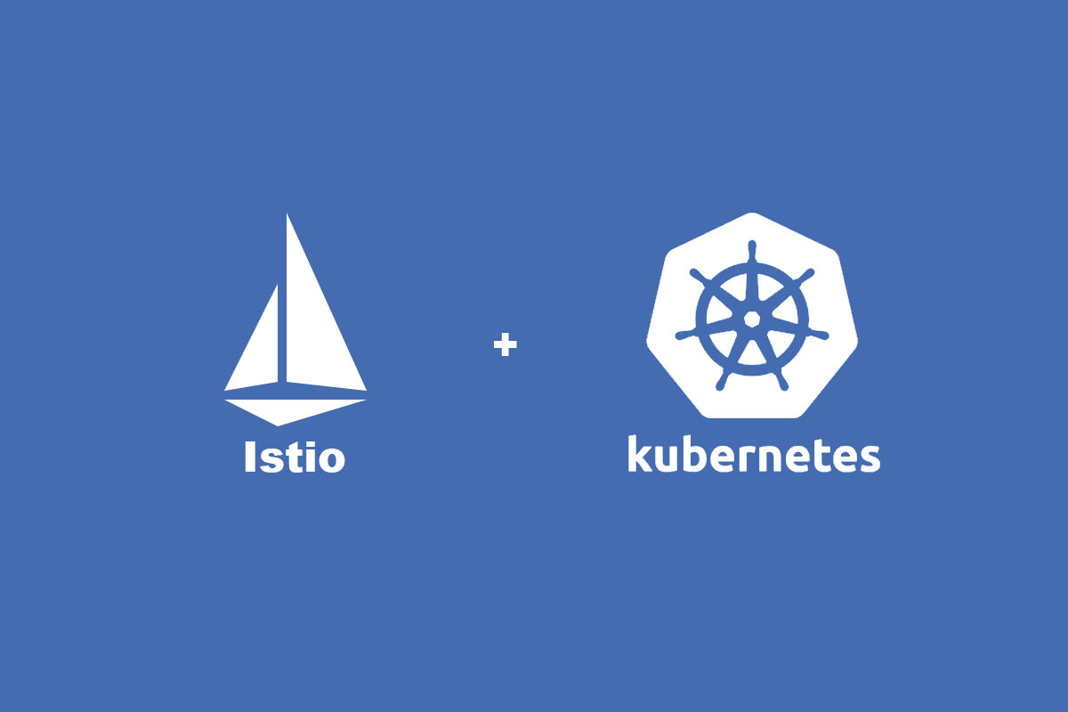
What separates them both ?

Slide 25
Istio VirtualService v/s Kubernetes Service
Istio's virtual service provides a lot of external features such as traffic management, load balancing, pod to external communication, routing , url restructuring.
Kubernetes simply acts as a container management system.
Kubernetes is a logical set of pods and defined as an abstraction on top of pods which provides single DNS name or IP.
Why Virtual Service ?
Istio VirtualService is kind of abstract thing, which trys to add an interface to the actual implementation like the service in Kubernetes
It defines a set of traffic routing rules to apply to a kubernetes service or subset of service based on the matching criteria.

Slide 26
Thank you!

Slide 27
